Slide 1
Background \1
Notes:
Slide Example 1 (Main Body Slide)
Source: Elena Banegas, Worcester Polytechnic Institute

Slide 2
Background \2
Notes:
Slide Example 1 (Main Body Slide)
Source: Elena Banegas, Worcester Polytechnic Institute

Slide 3
Background \3
Notes:
Slide Example 1 (Main Body Slide)
Source: Elena Banegas, Worcester Polytechnic Institute

Slide 4

Mono compartment Darcy model
Where p is the pressure, K the permeability of the compartment and s refers to the source term of the equation.
Notes:
Slide Example 1 (Main Body Slide)
Source: Elena Banegas, Worcester Polytechnic Institute

Slide 5
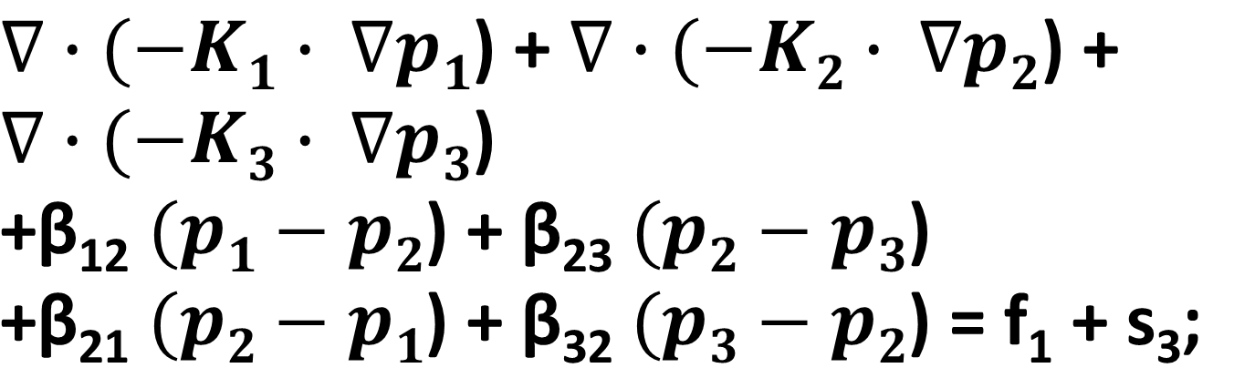
Three compartment Darcy model
Where β₁₂ = β₂₁ and β₂₃ = β₃₂ and with f₁ and s₃ we refers to the active filling term and the source term, respectively.
Notes:
Slide Example 1 (Main Body Slide)
Source: Elena Banegas, Worcester Polytechnic Institute

Slide 6
Unit cube Darcy model simulation
Notes:
Slide Example 1 (Main Body Slide)
Source: Elena Banegas, Worcester Polytechnic Institute

Slide 7
Left ventricle Darcy model simulation: active filling term and source term imposed
Notes:
Slide Example 1 (Main Body Slide)
Source: Elena Banegas, Worcester Polytechnic Institute

Slide 8
Preliminary results \1
Notes:
Slide Example 1 (Main Body Slide)
Source: Elena Banegas, Worcester Polytechnic Institute

Slide 9
Preliminary results \2
Notes:
Slide Example 1 (Main Body Slide)
Source: Elena Banegas, Worcester Polytechnic Institute

Slide 10
Preliminary results \3
Notes:
Slide Example 1 (Main Body Slide)
Source: Elena Banegas, Worcester Polytechnic Institute

